Slide 1
Parallelization of Sparse Coding & Dictionary Learning
Univeristy of Colorado Denver
Parallel Distributed System
Fall 2016
Huynh Manh

Slide 2
Contents
Introduction to Sparse Coding
Applications of Sparse Representation
Sparse Coding
Matching Pursuit Algorithm
Dictionary Learning
K-SVD algorithm
Challenges for parallelization
Implementation
References

Slide 3
Sparse Coding
Spare coding (i.e sparse approximation) is a process to find the sparse represenation of input data.
A sparse coding involves finding the "best matching" projections of multidimensional data onto the span of an over-complete (i.e., redundant) dictionary D.

Slide 4
Sparse Coding
Dictionary D (size $N x K)$is said to be over-complete if K > N.
The advantage of having an over-complete basis is that our basis vectors are better able to capture structures and patterns inherent in the input data.
The aim of sparse coding is to find a set of basis vectors $d_{i}$ (atom) such that we can represent an input vector $x$as a linear combination of these basis vectors
$$x=\sum_{i}^{k}{α_{i}d_{i}}$$

Slide 5
Applications
To obtain a compact high-fidelity representation of the observed signal.
To uncover semantic information. Such a sparse representation, if computed correctly, might naturally encode semantic information about the image.
Applications
Image/video compression
Image denosing/ restoration.
Image classfication/ object recognition
Multi-target tracking.
...

Slide 6
Applications
Image denoising
[J.Mairal 2008]

Slide 7
Applications
Face Recognition [Wright 2009]
This framework can handle errors due to occlusion and corruption uniformly by exploiting the
fact that these errors are often sparse with respect to the standard (pixel) basis.
Test images
Spare Representation
Dictionary
Error

Slide 8
Applications
Multi-target tracking
The goal of multi-target tracking is to track the targets, draw their trajectories by maintaining the identity in the whole video sequence.

Slide 9
Applications
Result from [Fagot-Bouquet 2015]

Slide 10
Sparse Coding
We aim to find sparse representation vector $α$of input vector $x$ by the relation:
$$Dα=x$$
K
N
N
Known

Slide 11
Sparse Approximation
$D:$ Dictionary $NxK$(N < K)
$x:$ input vector $Nx1$
$α:$ sparse representation of $x [Kx1]$
Undertermined system of linear equations $Dα=x$ having infinitely many solutions.
Among all (infinitely many) possible solutions we want the sparsest !!
Goal:
or
or

Slide 12
Sparse Coding
$D:$ Dictionary $NxK$(N < K)
$x:$ input vector $Nx1$
$α:$ sparse representation of $x [Kx1]$
This is a combinatorial problem, proven to be NP-Hard!
Here is a recipe for solving this problem:
Gather all the supports of cardinality L
Solve the LS problem
for each support
Set L=1
LS error ≤ ε² ?
No
Yes
There are (^{K}) such supports
^{L}
Set L=L+1
Assume: K=1000, L=10 (known!), 1 nano-sec per each LS
We shall need ~8e+6 years to solve this problem !!!!!
Done
Notes:
L chosen out of K

Slide 13
Sparse Coding
Relaxation methods
Smooth the L₀ and use continuous optimization techniques
Greedy methods
Build the solution one non-zero element at a time

Slide 14
Matching Pursuit Algorithms
The MP is a greedy algorithm that finds one atom at a time.
Step 1: find the one atom that best matches the signal.
Next steps: given the previously found atoms, find the next one to best fit …
Repeat step 1 until convergence.

Slide 15
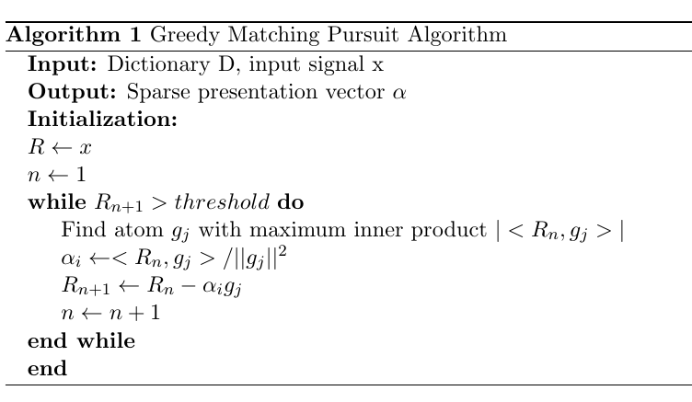
Matching Pursuit Algorithms

Slide 16
Matching Pursuit Algorithms
X
D
X
≈
$$α$$
≈
A
Each example is a linear combination of atoms from D
Each example has a sparse representation with no more than L atoms

Slide 17
Dictionary Learning
How to correctly choose the basis for representing the data ?
$$Dα=x$$
K
N
N
Known

Slide 18
K-SVD algorithm
Initialize
D
D
Sparse Coding
Use MP
T
T
X
$$α$$
Dictionary Update
Column-by-Column by SVD computation

Slide 19
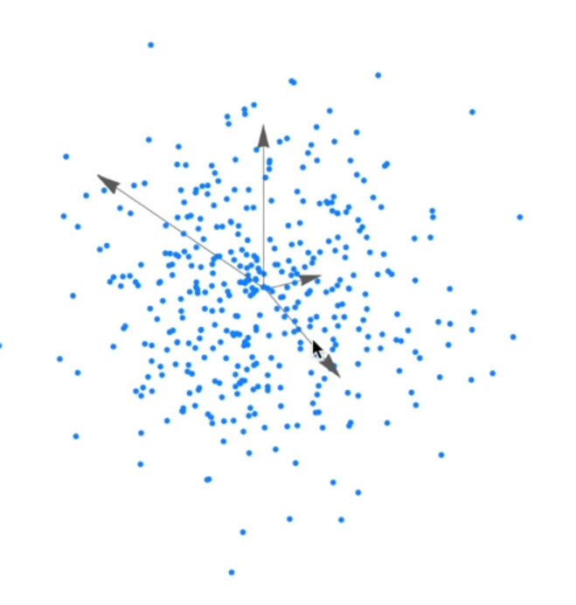
K-SVD algorithm
Here is three-dimensional data set,
spanned by over-complete dictionary of
four vectors.
What we want is to update each of these
vector to better represent the data.

Slide 20
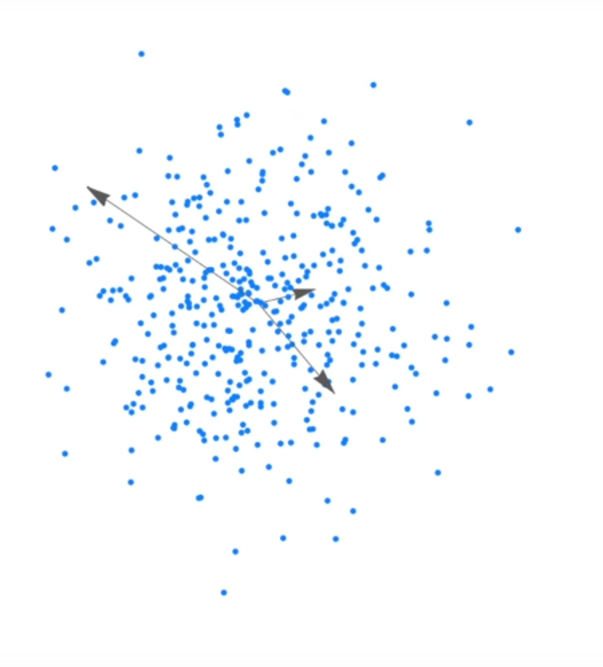
K-SVD algorithm
1. Remove one of these vector
If we do sparse coding using only three
vectors, from the dictionary, we cannot
perfectly represent the data.

Slide 21
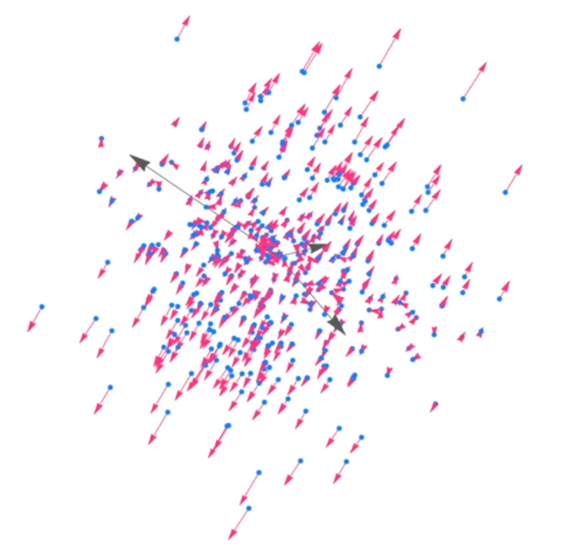
K-SVD algorithm
2. Find approximation error on each data point

Slide 22
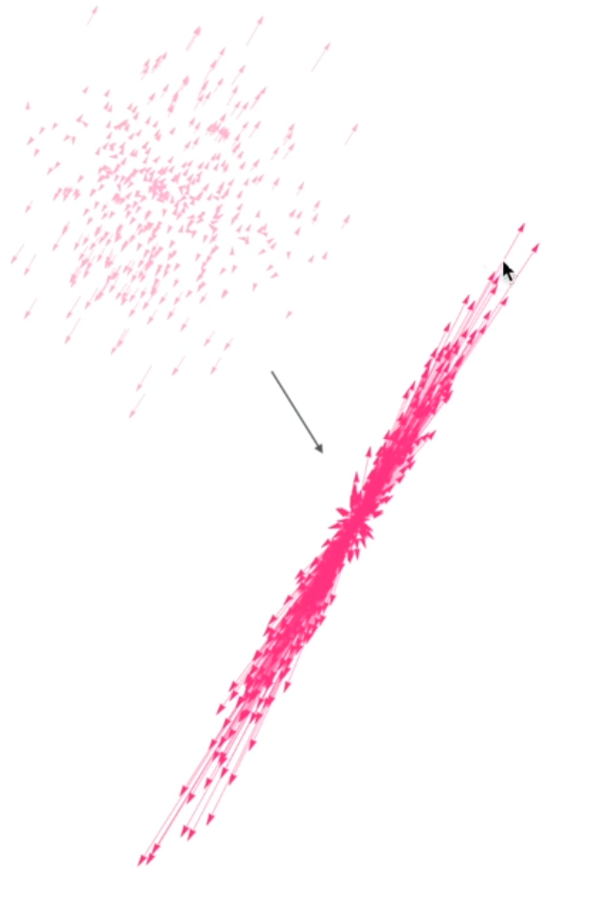
K-SVD algorithm
2. Find approximation error on each data point

Slide 23
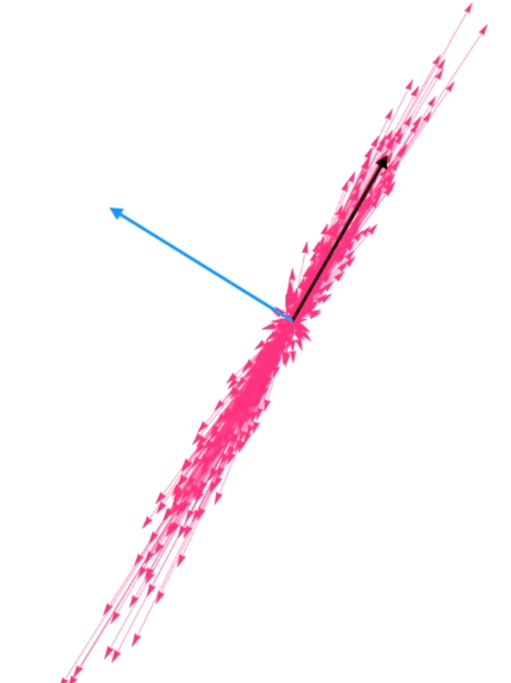
K-SVD algorithm
3. Apply SVD on error matrix
The SVD provides us a set of orthogonal
basis vector sorted in order of decreasing
ability to represent the variance error matrix.

Slide 24
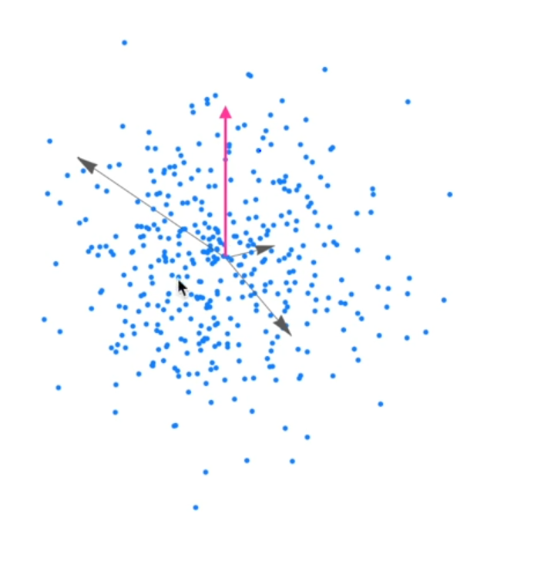
K-SVD algorithm
3. Replace the chosen vector with the
first eigenvector of error matrix.
4. Do the same for other vectors.

Slide 25
K-SVD algorithm
But, there is not all, but a few data points
using the chosen vector.
Then, it is not necessary to calculate error for
all data points, but instead a few of them that are
using the chosen vector.

Slide 26
K-SVD algorithm
D
T
$$α$$
X

Slide 27
K-SVD algorithm
1. Initialize the dictionary randomly
2. Using any pursuit algorithm to find a sparse coding $α,$ for
the input data X using dictionary D.
3. Update D:
a. Remove a basis vector $d_{k}$
b. Compute the approximation error $E_{k}$ on data points
that were actually using $d_{k}$
c. Take SVD of $E_{k}$
d. Update $d_{k}$.
4. Repeat to step 2 until convergence.

Slide 28
Challenges for parallelization
Real-time constraint for multi-target tracking (~ 15fps).
Dictionary size is increased over time.
Processing time for finding sparse coding for different human detection (input vector) are different.
If we allocate some of PEs unit dedicated to process each of input vector, then how to have good load balance.

Slide 29
Challenges for parallelization
K-SVD updates atoms one-by-one.
For multi-target tracking, input data is highly independent since there
is no more than 1 person indentity at the same frame. But, not completely independent.
Batching method: Figure out the independent atoms, and place them into a batch for processing. But, how about the cost of overhead ?

Slide 30
Implementation
C++ CUDA
To further improve performance:
Coalescing global memory
Using Shared memory.
Reducing thread divergence.

Slide 31
References
[1] https://www.mathworks.com/help/wavelet/ug/matching-pursuit-algorithms.html
[2] https://en.wikipedia.org/wiki/Sparse_approximation
[3] https://en.wikipedia.org/wiki/Matching_pursuit
[4] http://ufldl.stanford.edu/wiki/index.php/Sparse_Coding
[Wright 2009] Robust Face Recognition via Sparse Representation, CVPR 2009.
[Weizhi Lu 2013] Multi-object tracking using sparse representation, ICASSP 2013.
[Fagot-Bouquet 2015] Online multi-person tracking based on global sparse collaborative representations, ICIP 2015.
[Lu He 2016] Scalable 2D K-SVD Parallel Algorithm for Dictionary Learning on GPUs. In Proceedings of the ACM International Conference on Computing Frontiers

